Slide 1
Case Study:
Story of Bank of Ireland
Monalisa Singh
MSBA
KSU

Slide 2
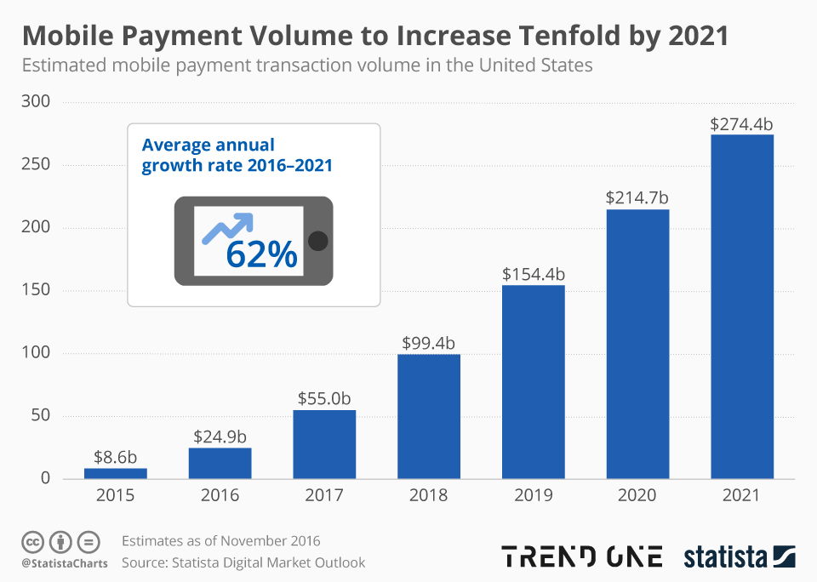
Digital Transformation of Banks (Why?)

Slide 3
What Special about BOI?
BOI’s idea behind transformation- person should be able to check and get his/her financial credibility at any time
BOI’s mobile system that works on cellphone and can be used by an individual at any time
A person can check their credibility and make efficient decisions
Doing this BOI achieved reduce in pressure on salesforce as well as increase market value

Slide 4
Analytical Capability Of BOI
Increasing their connections with more people.
Starting a campaign “People Like You” : Targeting 4 million people.
Creating 200 Micro-segments based on behaviour patterns.
Behaviour patterns like decision making, purchases, credit scores, likes/dislikes etc.
Personalising services according to the different Micro-segments.

Slide 5
Usage of Micro-Segments (Example)
A person who wants to buy a BMW Car. This is how BMI helps thus customer:
The person accesses the BOI app.
BOI checks the person’s profile: credit scores, etc.
The app uses this data and based on the generic behaviour pattern of the customer.
Based on the behaviour analysis of their customers, BOI determines the customer’s ability to take loan or not.
The idea is also to reduce the risk of loan while personalising the loan experience.

Slide 6
BOI’s Push/Pull Campaign
Transitioning from Push Campaigns to Pull Campaigns.
Push Campaigns: Targeting clients by personally approaching them.
Pull Campaigns:
1) Using predictive analytics using behavioral patterns of customers.
2) Creating sales funnel: Targeting only potential customers.
Increase in yield by 10-15%, which is more than the average (1-2%)
300K uplift in sales.

Slide 7
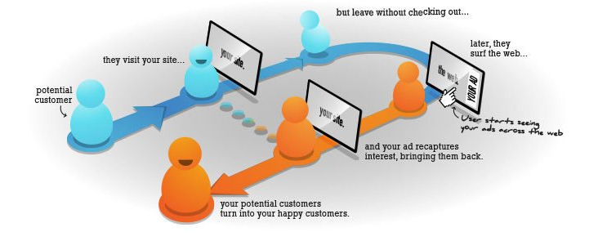
How accidental lead generation happens : Role of analytics

Slide 8
Price elasticity to acquire new customer : Using analytics
1. Directly engage with leads
2. Deploy outbound & inbound marketing
3. Invest in new technology
5. Develop & optimize informative content
6. Tap into databases
7. Optimize individual pages for relevant keywords

Slide 9
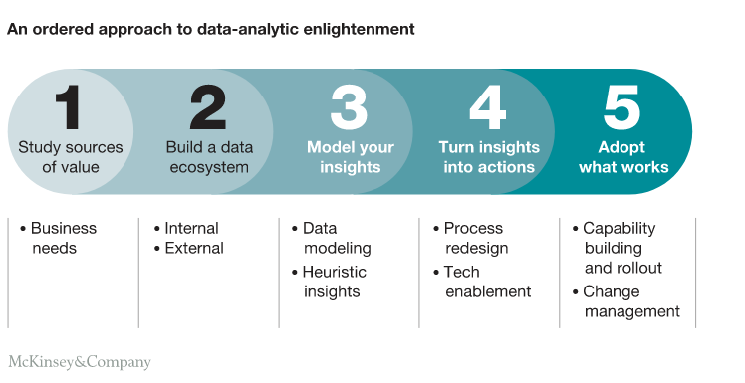
How Bank of Ireland uses data to understand the market

Slide 10
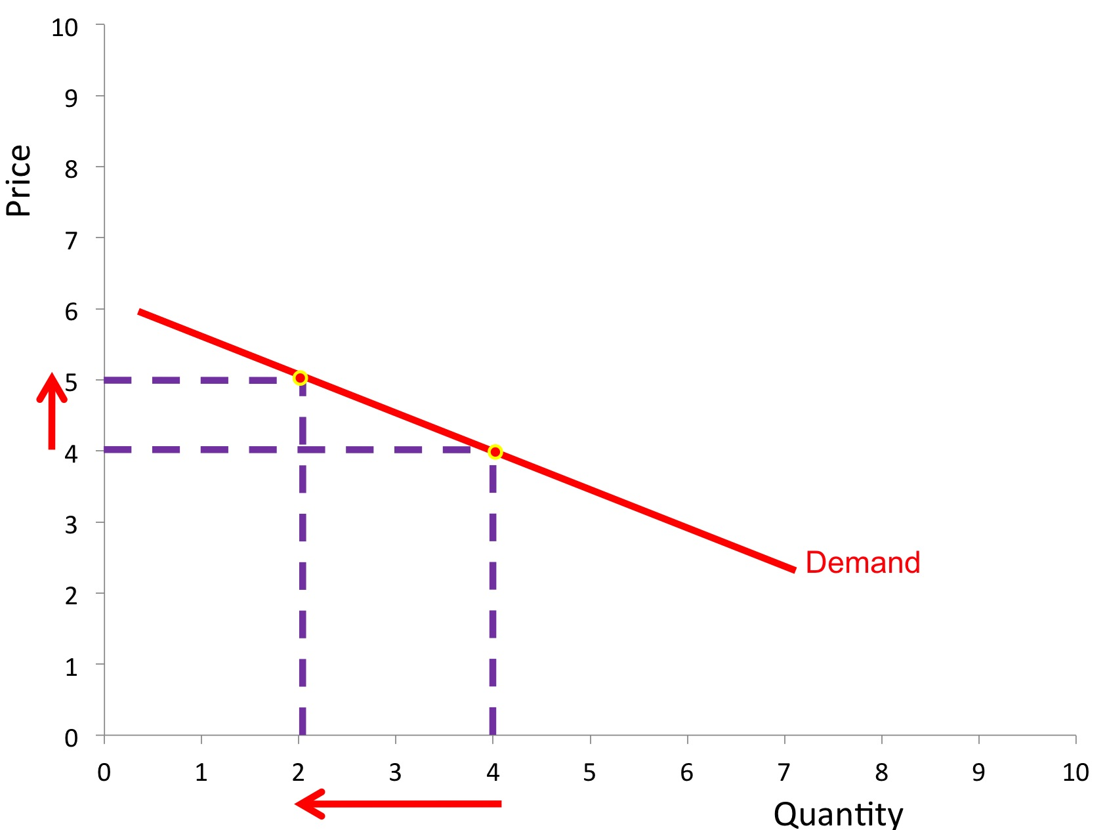
Price elasticity

Slide 11
Bank of ireland : Price elasticity
“People Like You” campaign is used here for observing the prices that the customers aspire to find.
5-10 basis points compared to 30-40 basis points on industry standard on mortgage rates
Bank of Ireland provides 10% price elasticity for important commodities , thus taking greater risk on the customer in hope of earning back on him in the future.
Current growth rate in digital payments is 20-25 % and BOI is targeting to have it up to 40 % by end of 2020

Slide 12
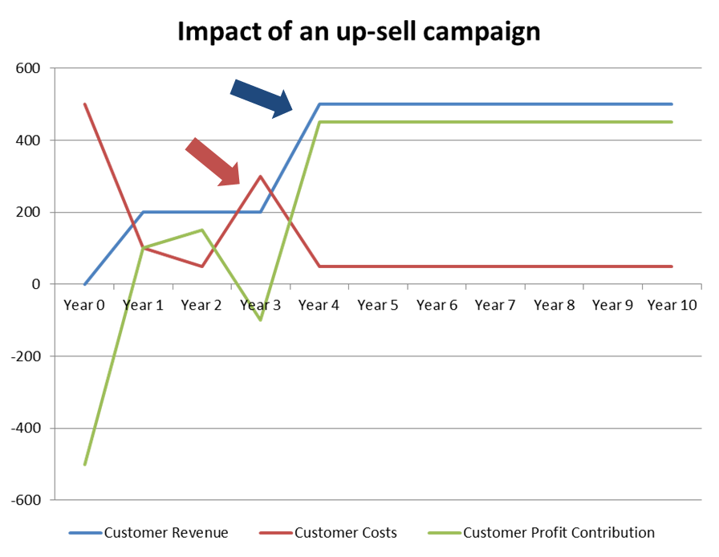
Cost of acquisition of (more likely person vs general audience) using Analytics

Slide 13
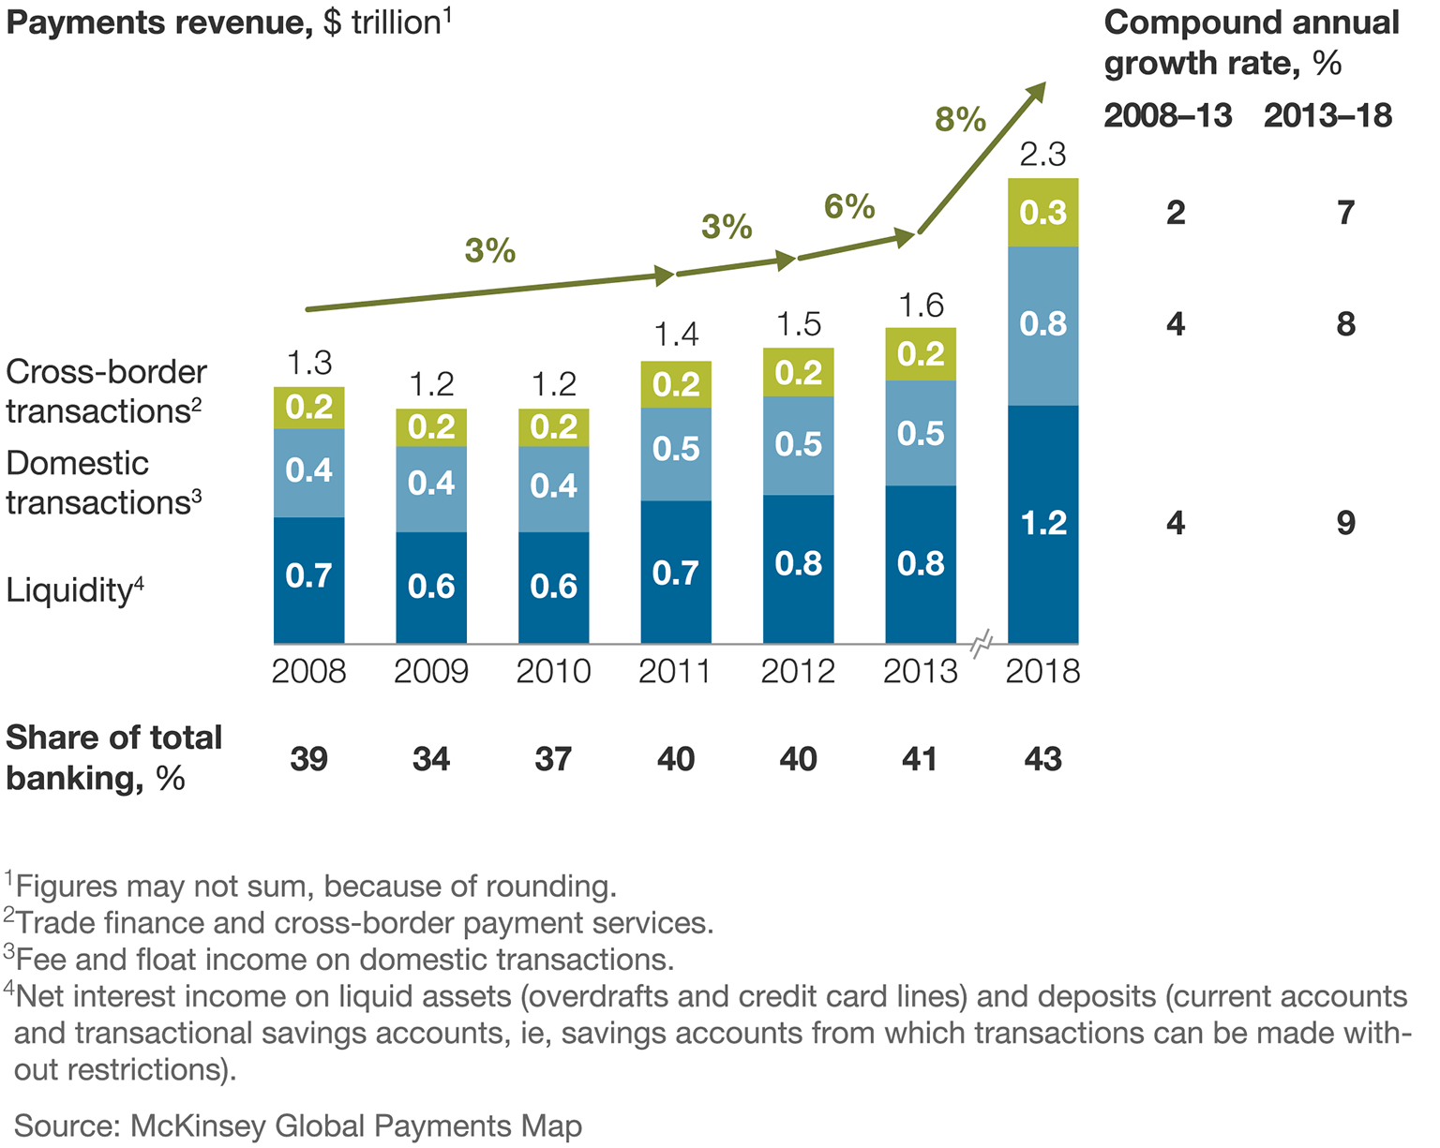
Final summary and future predictions

